Slide 1
Cost of Night-outs around the world
Venkata Vishnuvardhan Aluri

Slide 2
Data Description
This dataset comprises of information about night out prices in various cities around the world.
Two Categories of night outs – date night and party night
Each category Is further classified into various activities such as dinner, drinks, taxi, big mac etc.
Data source – dataworld.com
Representations followed.

Slide 3
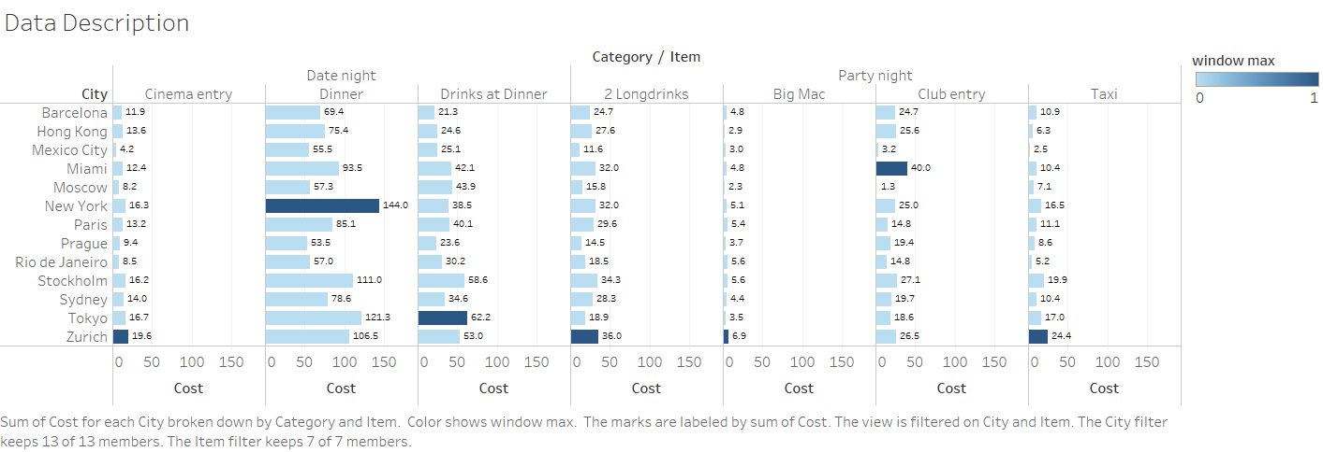
Insights into data

Slide 4
Questions Explored
Which city stands as costliest for night outs?
which city has costliest restaurants for dinner?
Scope for dashboards?
Which city has the costliest transportation?
What to choose in each city, date night or party night?
Are clubs cheaper than dinner for two?

Slide 5
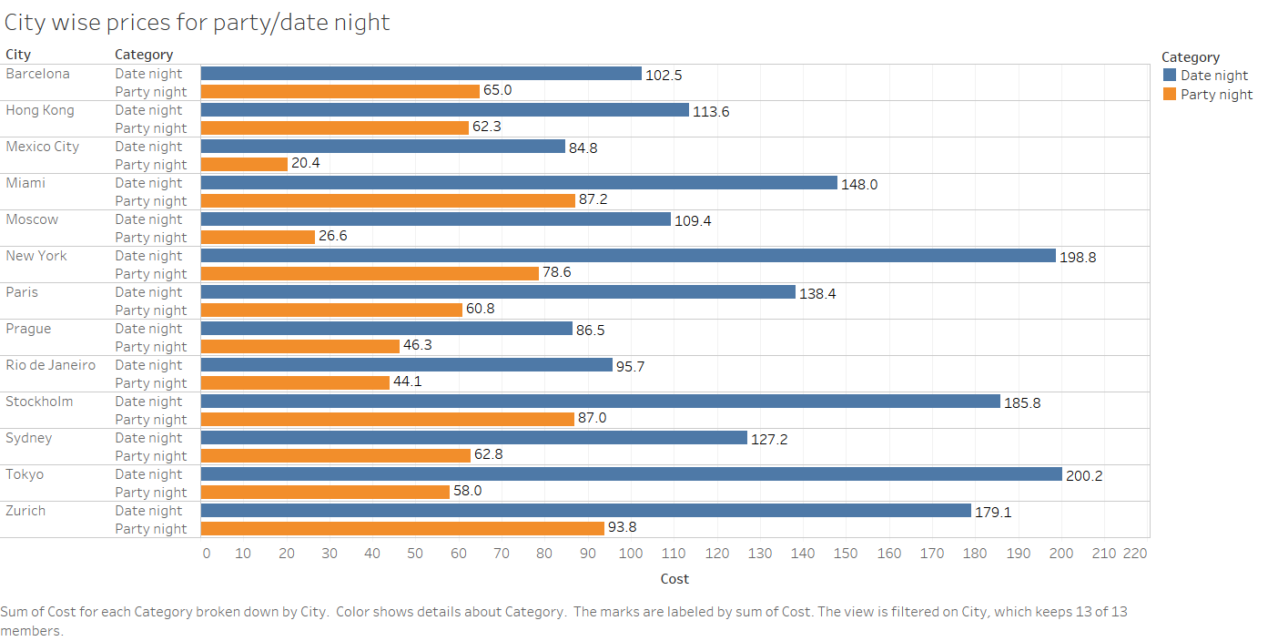
Date night vs party night prices

Slide 6
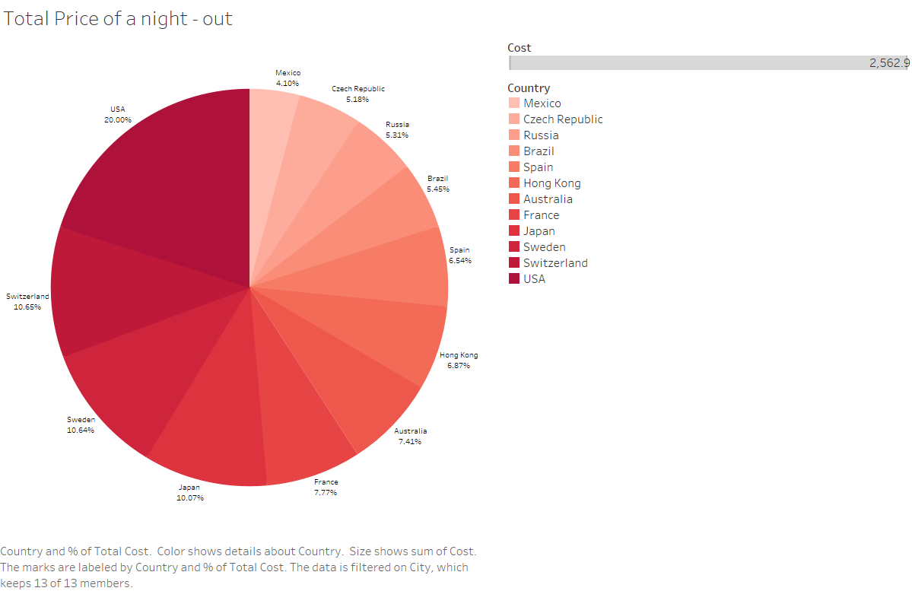
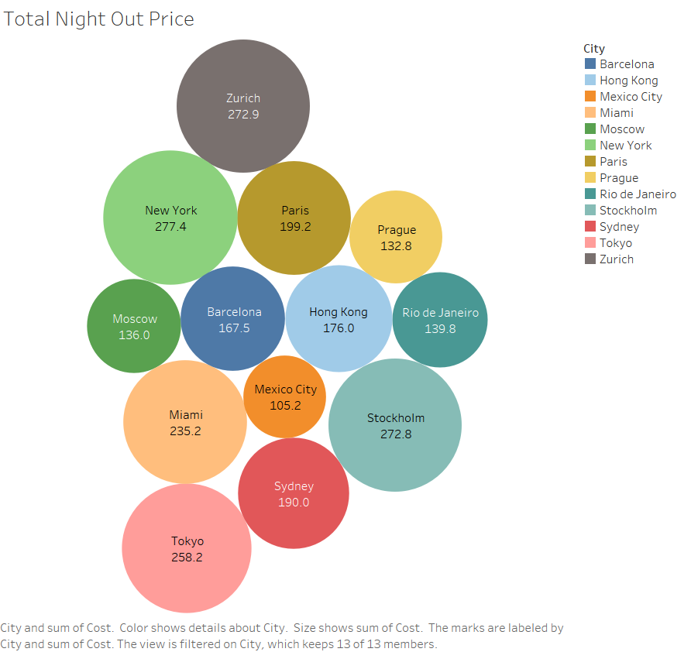
Country wise prices – percentages and share

Slide 7
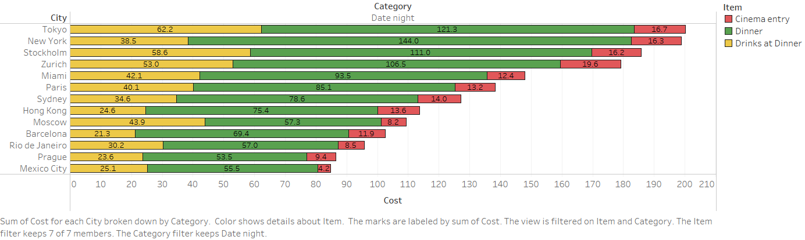
Costs - Item level granularity for date night

Slide 8
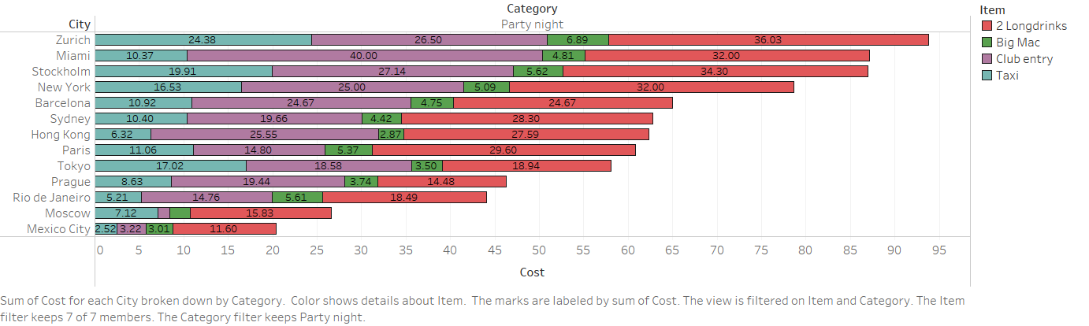
Costs - Item level granularity for party night

Slide 9
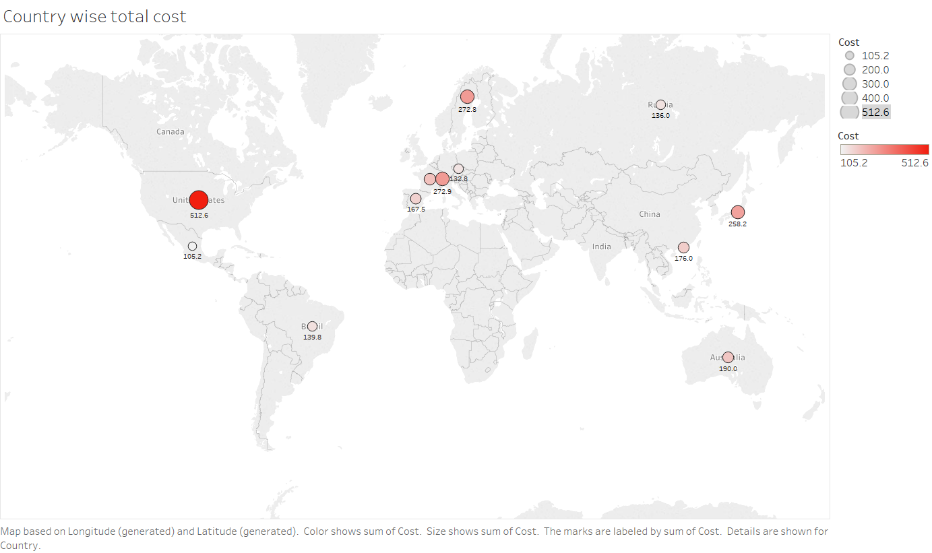
Globe view

Slide 10
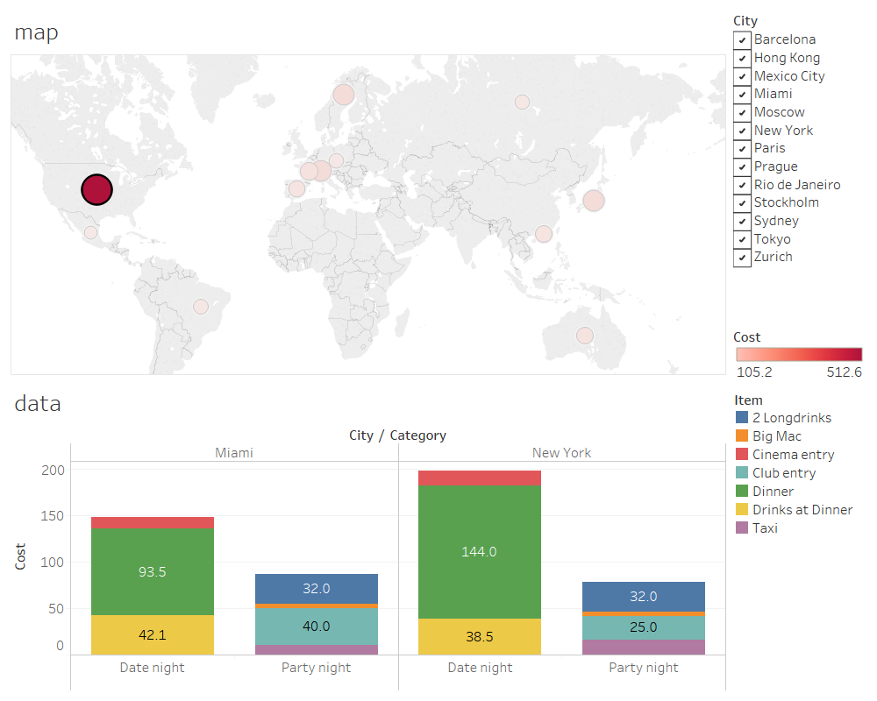
Dash board
Dash boards are dynamic, interactive and powerful.
Provide individual reports as needed automatically
Robust and easily understood

Slide 11
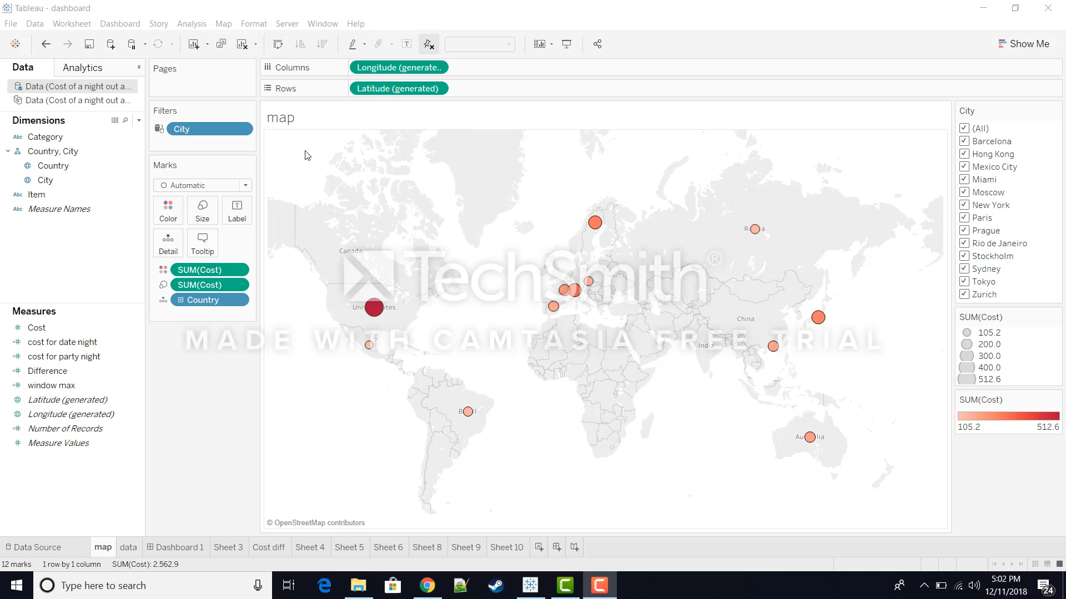
Dashboard Visualization

Slide 12
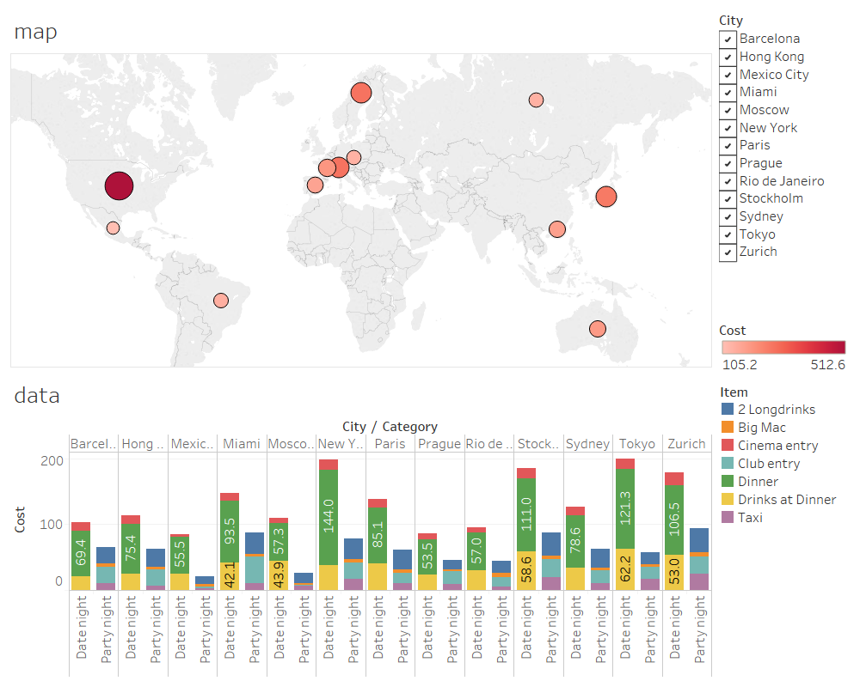
Dash board continued

Slide 13
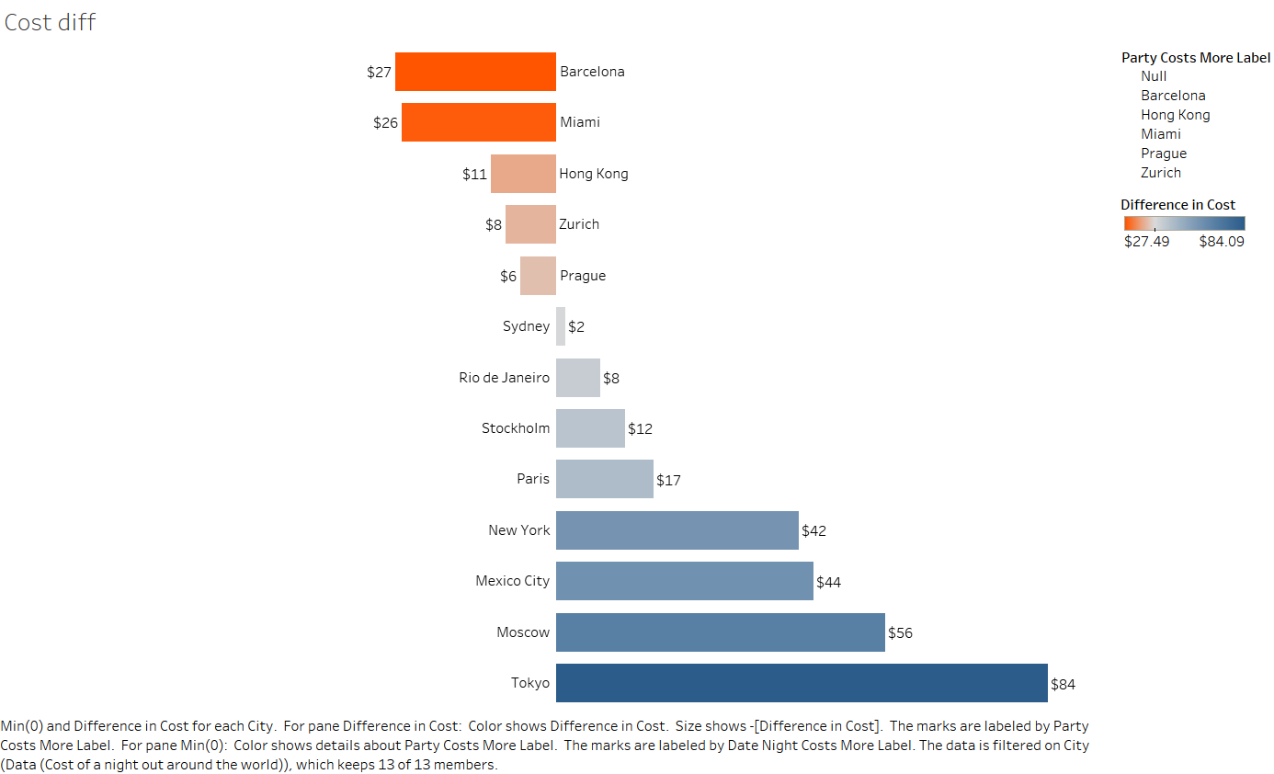
Which Is more cheaper – date vs party night out
Aggregation
Calculated fields

Slide 14
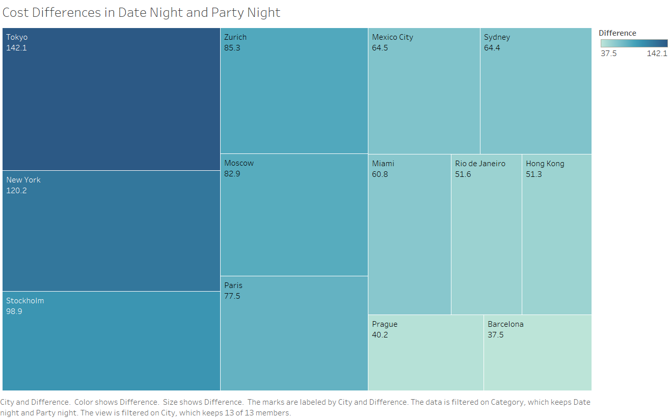
Difference in prices

Slide 15
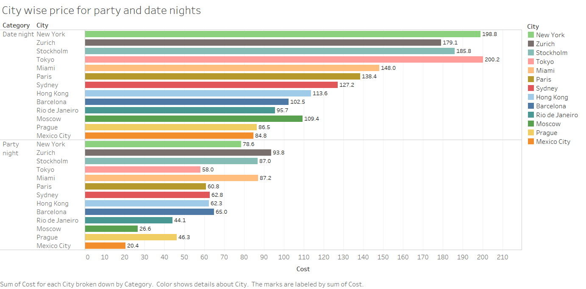
Interested challenges
Choosing the right representations

Slide 16

Thank you!

